Slide 1
RPA (UiPath) 1st Lab – 10/10/2021

Slide 2
UiPath Components
UiPath Studio: IDE where the robots are built (based on .NET Framework)
UiPath Assistant: desktop app from where the business users start the attended bots
UiPath Orchestrator: robots management cloud platform (attended & unattended bots)

Slide 3
UiPath Software Installation
Requirements:
Windows OS
Download link: https://cloud.uipath.com/portal_/register
sign up -> UiPath Cloud Platform -> Resource center -> Community edition (Stable – v. 2022.4)

Slide 4
UiPath Studio
IDE where you can create your automation workflow with the help of activities and execute the designed automation
Features:
GUI Dashboard – Offers a GUI dashboard which consists of pre-defined activities to build automation workflows
Complexity Levels – Allows you to create projects based on complexity levels such as Sequence, Flowchart and State Machine
Types of Recorders – Offers various types of recorders to record actions on multiple platforms such as Basic, Desktop, Web, Image, and Native Citrix
Logging & Exception Handling – Allows you to perform debugging and exception handling If you wish to learn how to use these options you can refer to my article on Error Handling
Integrate with OCR technologies – UiPath Studio can integrate with various OCR technologies to perform screen scraping
Reusable Components – With the UiPath Studio, you can create reusable components to publish them together as Libraries

Slide 5
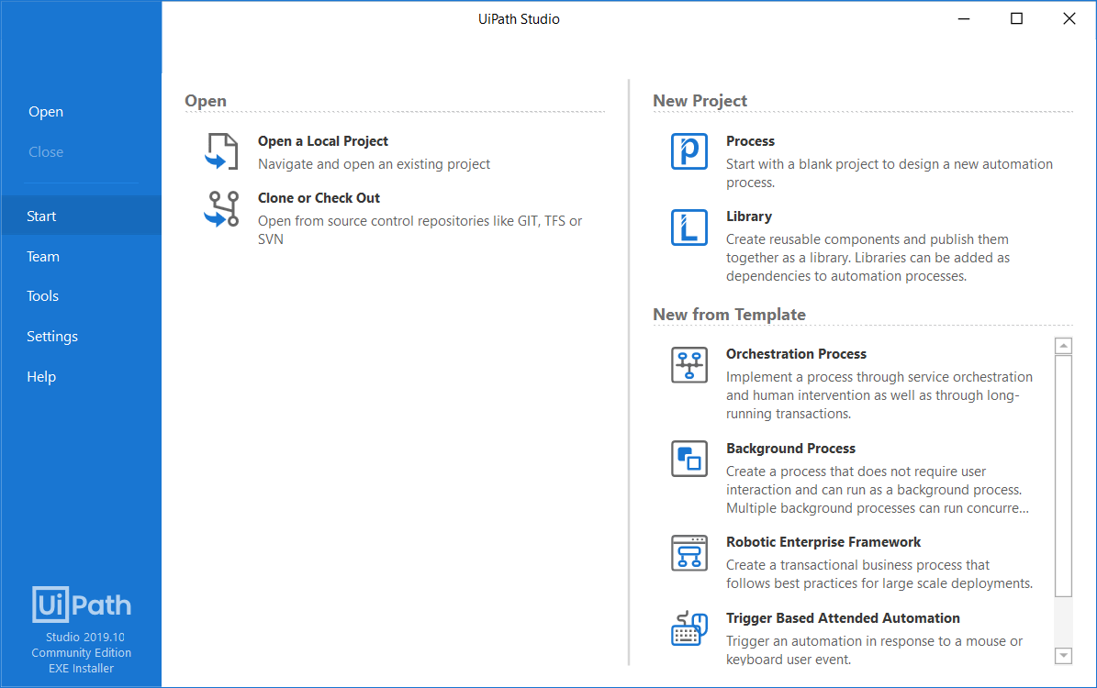
UiPath Studio – The User Interface
UiPath Studio contains multiple panels for easier access to specific functionalities. They can be docked, act as floating windows, or the Auto-hide option can be enabled from the drop-down list.
The Ribbon
Home
Start a new project from predefined templates or open a project you recently worked on. Projects can be pinned or removed from the Open Recent list, while hover over them displays the entire project Description. By default, projects are created in C:\Users\<<current user>>\Documents\UiPath. The Open a Local Project button searches for project.json files.

Slide 6
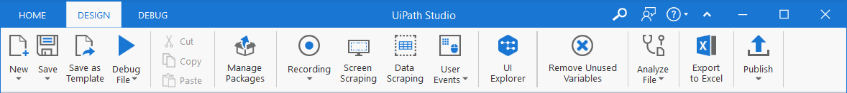
UiPath Studio – The User Interface
Ribbon
2. Design
Add sequences, flowcharts and state machines to your project, install and manage activities packages, built interactions with UI elements, export workflows to Excel, and then publish your work to Orchestrator or custom feeds. Keep in mind, that wizards and UI Explorer aren’t visible in the Ribbon unless you install the UiPath.UIAutomation.Activities package.

Slide 7
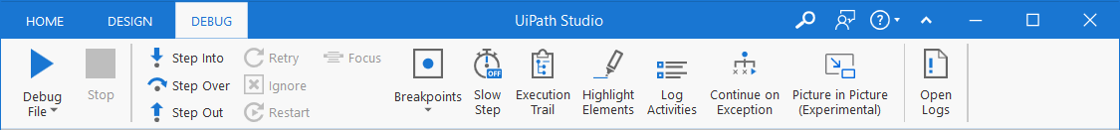
UiPath Studio – The User Interface
Ribbon
3. Debug
Debug your workflow, while using debugging tools to set breakpoints, monitor the execution of activities step by step, and adjust the debugging speed. Open logs to view details regarding execution and any change made to the project.

Slide 8
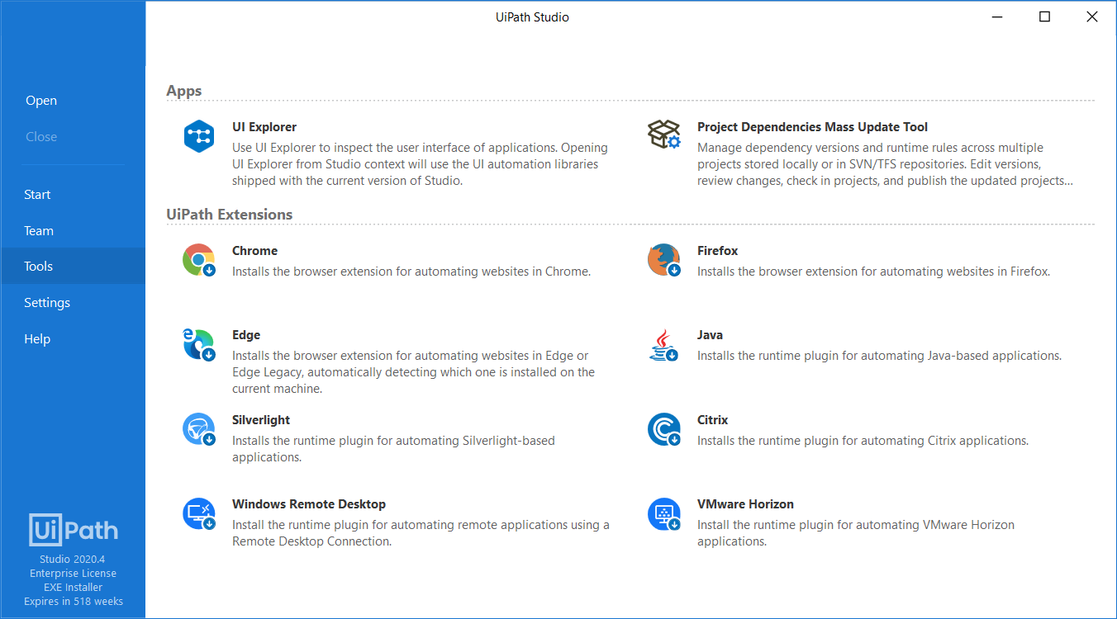
UiPath Studio – The User Interface
The tools tab
The Tools tab can be used for installing extensions for Chrome, Firefox, Edge, Java, Silverlight, Citrix and Windows Remote Desktop, and for launching the UI Explorer and Project Dependencies Mass Update Tool.

Slide 9
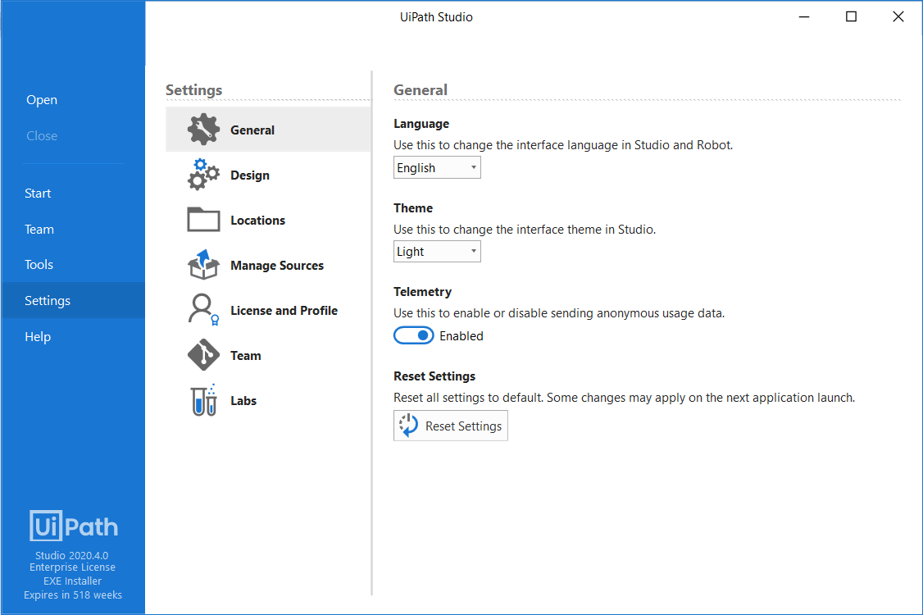
UiPath Studio – The User Interface
The Settings tab
The Settings tab has options for changing the interface language, theme, setting global preferences, and managing activity feeds.

Slide 10
UiPath Studio – The User Interface
General subsection
The General subsection includes the option to change the interface language for Studio and Robot, by picking one of the available languages.

Slide 11
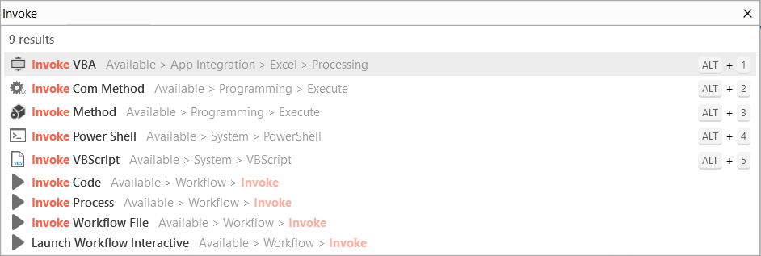
UiPath Studio – The User Interface
The command palette
The Command Palette is opened by using Ctrl + Shift + P, F3 keyboard shortcuts, or by clicking the search button. It incorporates the Add activity, the Universal search, the Go to file, and Jump to activity search bars.
The Add activity search bar
The Add activity search bar is opened using Ctrl + Shift + T keyboard shortcut. You can search for activities in installed packages and add them after selected activity in the file. The bar automatically assigns keyboard shortcuts to the first five results, and remembers your previous findings.

Slide 12
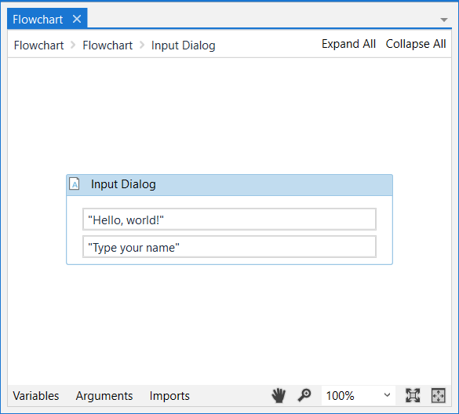
UiPath Studio – The User Interface
The Designer panel
The Designer panel displays your current automation project, enables you to make changes to it, and provides quick access to variables, arguments and imports.
It is possible to navigate within a diagram by double-clicking the activity you want to view.

Slide 13
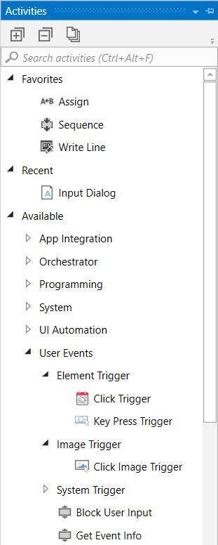
UiPath Studio – The User Interface
The Activities panel
The Activities panel shows available activities that can be added to the current workflow. Use search box to find activities, navigate through them using navigation keys and press Enter to add an activity to the current opened file.
The Project panel
The Project panel enables you to view the contents of the current project, add folders, open the file location, manage dependencies, and adjust project settings.

Slide 14
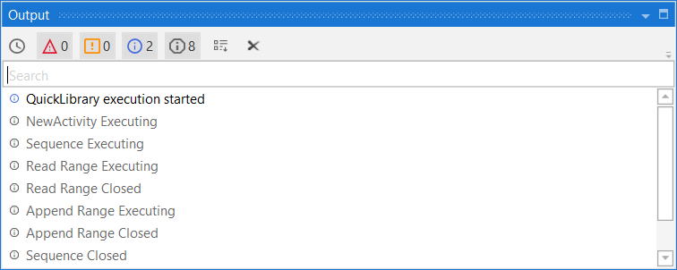
UiPath Studio – The User Interface
The Output panel
The Output panel enables you to display the output of the Log Message or Write Line activities, among other things. Exceptions for packages are also displayed in this panel.

Slide 15

Your first Robot

Slide 16
Print "Hello" by using Sequence activity
Print "Hello" by using Sequence activity
Objective: To code a Robot in UiPath Studio to print "Hello" in a message box and write line by using “Sequence” activity.
Learning Outcomes
After completion of this exercise you will get familiar with the following:
✓ “Sequence” and “Assign” activity.
✓ “Comment” and “Annotation”.
✓ “Message Box” activity.
✓ “Write Line” activity.
Algorithm:
Step 1: START
Step 2: Add Message Box activity and write " Hello" into Flow Chart Activity
Step 3: Add Write Line activity and write "Hello" in Flow Chart Activity
Step 4: STOP

Slide 17
Step by Step process: Step 1: Open UiPath Studio. Step 2: Create the process and name it. Step 3: Drag the “Sequence” activity from the activity panel and drop it in the workflow. Step 4: Name the “Sequence” activity as Sequence - ‘This code is an example of Sequence activity to display Hello using message box and write line activities’. Step 5: Drag and Drop the “Comment” activity in the “Sequence” activity and write the comment ‘// Write Hello using message box & write line activities’. Step 6: Drag and Drop the Message Box in “Sequence” activity and name it as Message Box – ‘To display Hello in a message box pop up’. Step 7: In the Text property of “Message Box – ‘To display Hello in a message box pop up’” write “hello”. Step 8: Drag and drop “Write line” activity and name it as Write Line – ‘To display Hello in the output panel’. Step 9: In the Text property of “Write line – ‘To display Hello in the output panel’” write “hello”.

Slide 18
Print "Hello" by using Flowchart activity
2. Print “Hello” by using Flowchart activity
Objective: To code a Robot using UiPath Studio Print "Hello" display "Hello" in a message box and write line by using “Flowchart” activity.
Learning Outcomes
After completion of this exercise, you will get familiar with the following:
✓ “Flowchart” activity.
✓ “Comment” and “Annotation”.
✓ “Message Box” activity.
✓ “Write Line” activity.
Algorithm:
Step 1: START
Step 2: Add Message Box activity and write " Hello" in “Sequence” activity
Step 3: Add Write Line activity and write "Hello" in “Sequence” activity
Step 4: STOP

Slide 19
Step by Step process: Step 1: Open UiPath Studio. Step 2: Create the process and name it. Step 3: Drag the “Flowchart” activity from the activity panel and drop it in the workflow. Step 4: Name the “Flowchart” activity as Flowchart - ‘This code is an example of Flowchart activity to display Hello using message box and write line activities’. Step 5: Drag and Drop the “Comment” activity in the “Flowchart” activity connect it with the Start node and write the comment ‘// Write Hello using message box & write line activities’. Step 6: Drag and Drop the Message Box in “Flowchart” activity connect it with “Comment” activity and name it as Message Box – ‘To display Hello in a message box pop up’. Step 7: In the Text property of “Message Box – ‘To display Hello in a message box pop up’” write “hello”. Step 8: Drag and drop “Write line” activity connect it with “Message Box – ‘To display Hello in a message box pop up’ and name it as Write Line – ‘To display Hello in the output panel’.

Slide 20
Addition of two numbers
Objective:
Code a Robot in UiPath Studio to display the sum of two numbers by taking them as input and display the output in a message box, until one of the input is 0.
Learning Outcomes
After completion of this exercise you will get familiar with the following:
✓ “Sequence” and “Assign” activity.
✓ “Comment” and “Annotation”.
✓ “Do While” activity and` how to set conditions.
✓ “Input Dialog” activity and how to set variables in a code using “Variable” panel.
✓ Display output in “Message Box”.
Algorithm:
Step 1: START
Step 2: Declare a variable 'FirstNumber' , 'Sum' , 'SecondNumber'
Step 3: Sum = FirstNumber + SecondNumber
Step 4: Do While FirstNumber < > 0 AND SecondNumber < >0
Step 5: STOP

Slide 21
Step by Step process: Step 1: Open UiPath Studio. Step 2: Create the process and name it. Step 3: Drag the “Sequence” activity from the activity panel and drop it in the workflow. Step 4: Name the “Sequence” activity as Sequence – 'This is a code to display the sum of two numbers until one of the input entered is 0'. Step 5: Add a “Comment” activity from the activity panel and write ‘// Code to display the sum of two number by taking them as input from user and display the output until one of the input is 0'. Step 6: Drag and drop the “Do While” activity from the activity panel and name it as Do While – 'Addition of numbers until one of the input value is not 0'. Step 7: Right-click on “Do While” activity, select Annotation > Add Annotation 'To take input from user and display the sum of numbers. This code will execute until one of the input is 0'. Step 8: In the body section of “Do While” activity drag and drop the “Sequence” activity. Step 9: Change the “Sequence” activity name Sequence – ‘To add two numbers and display the output in a message box’.

Slide 22
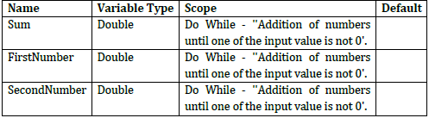

Step by Step process: Step 10: Create three variables from the “Variables” panel in the “Sequence” activity as under: Step 11: Drag and drop the “Input Dialog” activity inside the “Sequence” activity and name it as Input Dialog – 'First input by user'. Step 12: In the “Input Dialog” property, write the following values in Input Dialog properties panel: Step 13: Drag and drop “Input Dialog” activity inside the “Sequence” activity and name it as Input Dialog – 'Second input by user'.

Slide 23

Step by Step process: Step 14: In the “Input Dialog” property, write the following values in “Input Dialog” properties panel: Step 15. Drag and drop the “Assign” activity below the “Input Dialog” activity. Step 16: Change the “Assign” activity and name it as Assign – ‘Addition of numbers entered by user and assign the value to the variable Sum’. Step 17: Declare the ’Sum’ variable in the To section and ‘FirstNumber + SecondNumber’ in the Value section of Property. Step 18: Drag and drop the “Message Box” activity from the activity panel and name it as Message Box – ‘Display the output’ and inside the text field write “Sum of numbers entered is :- "+Sum.ToString Step 19: Inside the “Do While” activity, write the condition “FirstNumber <>0 AND SecondNumber <>0”.

Slide 24
Displaying a Sun Sign
Objective:
Code a Robot in UiPath Studio to display the sun sign of an individual by entering the Date of birth of an individual and produce the output in the message box.
Learning Outcomes
After completion of this exercise you will get familiar with the following:
✓ “Sequence” and “Assign” activity.
✓ “Comment” and “Annotation”.
✓ “Open Browser” and “Maximize Window” activity.
✓ “If” activity and how to set conditions.
✓ “Input Dialog”, “Type Into”, and “Click” activity and how to set variables in a code using “Variable” panel.
✓ Display output in “Message Box”.
Algorithm:
Step 1: START
Step 2: Open the URL using Open Browser Activity
Step 3: Declare the variables as 'Dates' , 'Months' , 'Years' , 'SunSign' ,'ElementExist'
Step 4: Use ElementExist variable to check text boxes are available in the browser
Step 5: Add If-Else block activity and add ElementExist in the condition text box
Step 6: In the If block use variables 'Dates' , 'Months' , 'Years' to store them
Step 7: In the Else block write "Sun sign couldn't be generated, Page not Found"
Step 8: STOP

Slide 25

Step by Step process: Step 1: Open UiPath Studio. Step 2: Create the process and name it. Step 3: Drag the “Sequence” activity from the activity panel and drop it in the workflow. Step 4: Name the “Sequence” activity as Sequence – ‘This code is for identifying the Sun Sign of an individual by entering Date of Birth.’ Add a “Comment” activity from the activity panel and write ‘// To generate Sun Sign of an individual by getting the date of birth as an input.’ Step 5: Drag and drop the “Open Browser” activity from the activity panel and name it as Open Browser – ‘Opens a specific browser using specified URL’ and inside the URL text field write: "https://astrologyfutureeye.com/astro-calculators/sun-sign-calculator" Step 6: Change the name of “Do” sequence from the “Open Browser” activity as Do – ‘Get date of birth as input from user, entering it in the browser text boxes and display the sun sign.’ Step 7: Drag the “Maximize Window” activity from the activity panel and drop it in the workflow. Step 8: Name the “Maximize Window” activity as Maximize Window – ‘To maximize the browser window.’ Step 9: Drag and Drop “Input Dialog” activity and name it as Input Dialog – ‘Date of birth entered by user’ and write the values as under:

Slide 26



Step by Step process: Step 10: Create a variable through “Variables” panel for the “Input Dialog” activity as under: Step 11: Declare the variable Dates in the “Output” Property of “Input Dialog” activity. Step 12: Drag and Drop “Input Dialog” activity and name it as Input Dialog – ‘Month entered by user’ and write the values as under: Step 13: Create a variable through “Variables” panel for the “Input Dialog” activity as under: Step 14: Declare the variable Months in the “Output” Property of “Input Dialog” activity.

Slide 27



Step by Step process: Step 15: Drag and Drop “Input Dialog” activity and name it as Input Dialog – ‘Year entered by user’ and write the values as under: Step 16: Create a variable through “Variables” panel for the “Input Dialog” activity as under: Step 17: Declare the variable Years in the “Output” Property of “Input Dialog” activity. Step 18: Drag the “Element Exists” activity from the activity panel and drop it in the workflow. Step 19: Name the “Element Exists” activity as Element Exists – ‘To check if the sun sign finder block exists in the website.’ Step 20: Create a variable through “Variables” panel for the “Element Exists” activity as under:

Slide 28
Step by Step process: Step 21: Declare the variable ElementExist in the “Output” Property of “Element Exists” activity. Step 22: Drag the “IF” activity from the activity panel and drop it in the workflow. Step 23: Name the “IF” activity as IF – ‘Condition to check if the Sun sign finder exists or no. If exists then the code will continue, and if not then display an error message.’ Step 24: Use the ElementExist Variable in the condition box of “IF” activity. Step 25: Drag the “Sequence” activity from the activity panel and drop it in the “Then” workflow. Step 26: Name the “Sequence” activity as Sequence – ‘Enter Date of Birth (Date, Month, Year).’ Step 27: Drag the “Sequence” activity from the activity panel and drop it in the workflow. Step 28: Name the “Sequence” activity as Sequence – ‘Date.’ Step 29: Right-click on “Sequence” activity select Annotation > Add Annotation ‘Entering and selecting the Date by identifying if in the dropdown menu.’ Step 30: Drag the “Click” activity from the activity panel and drop it in the “Sequence” activity.

Slide 29
Step by Step process: Step 31: Name the “Click” activity as Click - 'To click and select the date from the date block.’ Step 32: Drag the “Send Hotkey” activity from the activity panel and drop it in the “Sequence” activity. Step 33: Name the “Send Hotkey” activity as Click - 'To make the dropdown date visible.’ Step 34: In the “Send Hotkey” activity select the “enter” key from the “Key” dropdown menu. Step 35: Drag the “Type Into” activity from the activity panel and drop it in the “Sequence” activity. Step 36: Name the “Type Into” activity as Type into - 'To select the date box.’ Step 37: Declare the variable “Dates” in the “Input” Property of “Type Into” activity. Step 38: Drag the “Sequence” activity from the activity panel and drop it in the Sequence – ‘Enter Date of Birth (Date, Month, Year)’ workflow. Step 39: Name the “Sequence” activity as Sequence – ‘Month.’ Step 40: Right-click on “Sequence” activity select Annotation > Add Annotation ‘Entering and selecting the month by identifying it from the dropdown menu.’

Slide 30
Step by Step process: Step 41: Drag the “Click” activity from the activity panel and drop it in the “Sequence” activity. Step 42: Name the “Click” activity as Click - 'To Click and select the month from the month block.’ Step 43: Drag the “Send Hotkey” activity from the activity panel and drop it in the “Sequence”. Step 44: Name the “Send Hotkey” activity as Click - 'To make the dropdown month visible.’ Step 45: In the “Send Hotkey” activity select the “enter” key from the “Key” dropdown menu. Step 46: Drag the “Type Into” activity from the activity panel and drop it in the “Sequence” activity. Step 47: Name the “Type Into” activity as Type into - 'To Select the month box.’ Step 48: Declare the variable “Months” in the “Input” Property of “Type Into” activity. Step 49: Drag the “Sequence” activity from the activity panel and drop it in the Sequence – ‘Enter Date of Birth (Date, Month, Year)’ workflow. Step 50: Name the “Sequence” activity as Sequence – ‘Year.

Slide 31
Step by Step process: Step 51: Right-click on “Sequence” activity select Annotation > Add Annotation ‘Entering and selecting the year by identifying it from the dropdown menu.’ Step 52: Drag the “Click” activity from the activity panel and drop it in the “Sequence” activity. Step 53: Name the “Click” activity as Click - 'To Click and select the year from the year block.’ Step 54: Drag the “Send Hotkey” activity from the activity panel and drop it in the “Sequence”. Step 55: Name the “Send Hotkey” activity as Click - 'To make the dropdown Year visible.’ Step 56: In the “Send Hotkey” activity select the “enter” key from the “Key” dropdown menu. Step 57: Drag the “Type Into” activity from the activity panel and drop it in the “Sequence” activity. Step 58: Name the “Type Into” activity as Type into - 'To Select the year box.' Step 59: Declare the variable “Years” in the “Input” Property of “Type Into” activity. Step 60: Drag the “Click” activity from the activity panel and drop it in the Sequence – ‘Enter Date of Birth (Date, Month, Year) workflow.

Slide 32
Step by Step process: Step 61: Name the “Click” activity as Click – ‘Click on the calculate button to show the zodiac dashboard web screen.’ Step 62: Drag the “Get Value” activity from the activity panel and drop it in the “Sequence” workflow. Step 63: Name the “Get Value” activity as Get Value – ‘Get the Sun Sign.’ Step 64: Declare the variable “Sun sign” in the “Output” Property of “Get Value” activity. Step 65: Drag the “Message Box” activity from the activity panel and drop it in the “Sequence” workflow. Step 66: Name the “Message Box” activity as Message Box - 'To print Zodiac sun sign on screen.' Step 67: Drag the “Message Box” activity from the activity panel and drop it in the “Else” workflow of If – ‘Sun sign finder exists, enter values else print message’ activity. Step 68: Declare the variable "Sun Sign couldn't be generated, Page not Found" in the “Input” Property of “Message box” activity.
3…2…1… GO!

Slide 33
Get current time in Bucharest (optional homework)
Objective: Get the current time in Bucharest (or another region of your choice) using Google search (“Bucharest current time”)

